Slide 1
Robust Real-time Face Detection by
Paul Viola and Michael Jones, 2002
Presentation by Kostantina Palla & Alfredo Kalaitzis
School of Informatics
University of Edinburgh
February 20, 2009

Slide 2
Overview
Robust – very high Detection Rate (True-Positive Rate) & very low False-Positive Rate… always.
Real Time – For practical applications at least 2 frames per second must be processed.
Face Detection – not recognition. The goal is to distinguish faces from non-faces (face detection is the first step in the identification process)
Notes:
קצת על המאמר
פורסם ב 2001
מתעסק במטלת ה Object detection, והודגם ספציפית על מטלת ה Face detection.
גם כן המוטיבציה מאחורי היוזמה.
עם דגש משמעותי על מהירות
מערכת real time face detection הראשונה בעולם
מומש, שוכלל והורחב
בין השאר ממומש בחבילת OpenCV
הדוגמאות שלי
מעט יותר משוכלל, אבל אותו עיקרון
בעיות
האם זה משנה היכן המאמר פורסם?
האומנם first real-time face detection?
International journal of computer vision

Slide 3
Three goals & a conlcusion
Feature Computation: what features? And how can they be computed as quickly as possible
Feature Selection: select the most discriminating features
Real-timeliness: must focus on potentially positive areas (that contain faces)
Conclusion: presentation of results and discussion of detection issues.
How did Viola & Jones deal with these challenges?
Notes:
בשר המאמר מתחיל בעצם עכשיו – עד עכשיו הדגמה.

Slide 4
Three solutions
Feature Computation The “Integral” image representation
Feature Selection The AdaBoost training algorithm
Real-timeliness A cascade of classifiers
Notes:
בשר המאמר מתחיל בעצם עכשיו – עד עכשיו הדגמה.

Slide 5
Features
Overview | Integral Image | AdaBoost | Cascade
Can a simple feature (i.e. a value) indicate the existence of a face?
All faces share some similar properties
  The eyes region is darker than the upper-cheeks.
  The nose bridge region is brighter than the eyes.
  That is useful domain knowledge
Need for encoding of Domain Knowledge:
  Location - Size: eyes & nose bridge region
  Value: darker / brighter
Notes:
אבני הבניין של ה Classifiers
באמצעותם אנו מייצגים אובייקטים.
פיצ'ר היא פונקציה שמחשבת הפרשים בין אזורים מבלניים בתמונה
מתואר ויזואלית ע"י מלבן מחולק לתתי מלבנים, שחלקם לבנים וחלקם אפורים.
ההפרש שמחושב הוא בין המלבנים בצבעים השונים.
למשל...
במאמר אנחנו משתמשים בארבעה סוגי פיצ'רים
מידע נוסף
3 rectangular features types:
two-rectangle feature type (horizontal/vertical)
three-rectangle feature type
four-rectangle feature type
Doesn’t operate on raw grayscale pixel values but rather on values obtained from applying simple filters to the pixels.

Slide 6
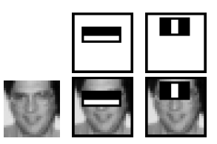
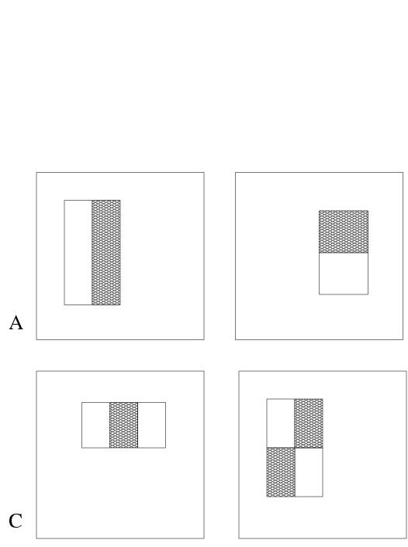
Rectangle features
Overview | Integral Image | AdaBoost | Cascade
Rectangle features:
  Value = ∑ (pixels in black area) - ∑ (pixels in white area)
  Three types: two-, three-, four-rectangles, Viola&Jones used two-rectangle features
  For example: the difference in brightness between the white &black rectangles over a specific area
Each feature is related to a special location in the sub-window
Each feature may have any size
Why not pixels instead of features?
  Features encode domain knowledge
  Feature based systems operate faster
Notes:
נדגים את השימוש בפיצ'רים על פרצופים.
פנים ניתן לתאר היטב באמצעות פיצרים
יש חלקים בולטים יותר כגון האף המצח והלחיים שסופגות יותר אור.
לעומתן איזורים שקועים יותר כגון ארובות העיניים, שמוצללות יותר.
בנוסף לשיער, פה, ומבנה הגולגולת.
כך שיש לנו הפרשי בהירות מובהקים.
למשל...
מה קורה אם נבנה classifier סופי משני הפיצ'רים הללו?
נקבל 100% detection rate, 40% false positive rate
אלו תוצאות לא מספקות לשם זיהוי
אבל נעזר בתוצאות בהמשך לשם סינון ראשוני של חלונות רקע.
מכאן הלאה האלגוריתם שלנו לא יתעסק ישירות עם הפיקסלים בתמונה, אלא אך ורק באמצעות חישובי פיצ'רים – קרי הפרשים.
שיפורים
אולי אפילו לשים תמונה מוכרת יותר

Slide 7
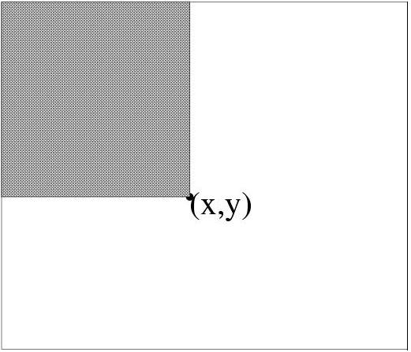
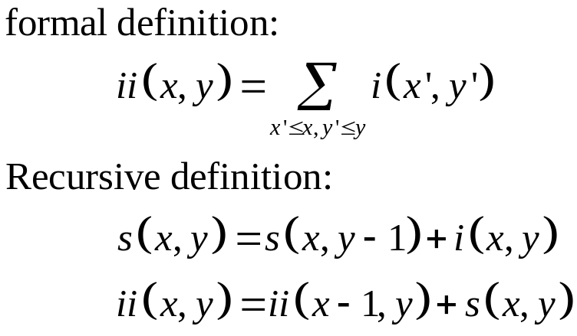
Integral Image Representation
(also check back-up slide #1)
Overview | Integral Image | AdaBoost | Cascade
x
Given a detection resolution of 24x24 (smallest sub-window), the set of different rectangle features is ~160,000 !
Need for speed
Introducing Integral Image Representation
  Definition: The integral image at location (x,y), is the sum of the pixels above and to the left of (x,y), inclusive
The Integral image can be computed in a single pass and only once for each sub-window!
y
Notes:
הגדרה:
בע"פ: היצוג האינטגרלי של תמונה בנקודה X,Y הוא סכום הפיקסלים שמעל ומשמאל לנקודה, כולל.
פרומאלית:
רקורסיבית
חישוב במעבר אחד
סיבוכיות זמן כגודל התמונה

Slide 8
back-up slide #1
Overview | Integral Image | AdaBoost | Cascade
IMAGE
INTEGRAL IMAGE
0 | 1 | 1 | 1
1 | 2 | 2 | 3
1 | 2 | 1 | 1
1 | 3 | 1 | 0
0 | 1 | 2 | 3
1 | 4 | 7 | 11
2 | 7 | 11 | 16
3 | 11 | 16 | 21
Notes:
הגדרה:
בע"פ: היצוג האינטגרלי של תמונה בנקודה X,Y הוא סכום הפיקסלים שמעל ומשמאל לנקודה, כולל.
פרומאלית:
רקורסיבית
חישוב במעבר אחד
סיבוכיות זמן כגודל התמונה

Slide 9
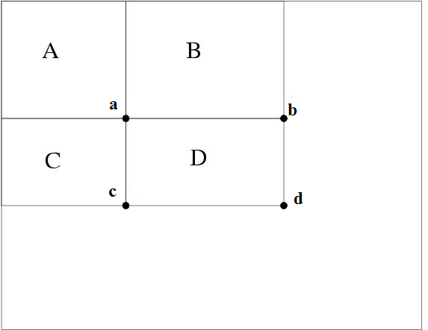
Rapid computation of rectangular features
Overview | Integral Image | AdaBoost | Cascade
Back to feature evaluation . . .
Using the integral image representation we can compute the value of any rectangular sum (part of features) in constant time
  For example the integral sum inside rectangle D can be computed as:
  ii(d) + ii(a) – ii(b) – ii(c)
two-, three-, and four-rectangular features can be computed with 6, 8 and 9 array references respectively.
As a result: feature computation takes less time
ii(a) = A
ii(b) = A+B
ii(c) = A+C
ii(d) = A+B+C+D
D = ii(d)+ii(a)-ii(b)-ii(c)

Slide 10
Three goals
Overview | Integral Image | AdaBoost | Cascade
Feature Computation: features must be computed as quickly as possible
Feature Selection: select the most discriminating features
Real-timeliness: must focus on potentially positive image areas (that contain faces)
How did Viola & Jones deal with these challenges?
Notes:
בשר המאמר מתחיל בעצם עכשיו – עד עכשיו הדגמה.

Slide 11
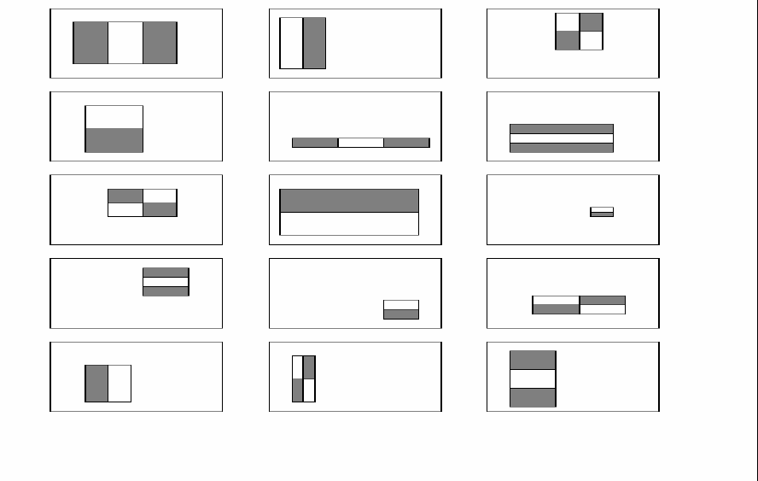


Feature selection
Overview | Integral Image | AdaBoost | Cascade
Problem: Too many features
  In a sub-window (24x24) there are ~160,000 features (all possible combinations of orientation, location and scale of these feature types)
  impractical to compute all of them (computationally expensive)
We have to select a subset of relevant features – which are informative - to model a face
  Hypothesis: “A very small subset of features can be combined to form an effective classifier”
  How?
    AdaBoost algorithm
Relevant feature
Irrelevant feature
Notes:
לא מספיק למצוא את הפיצרים הכי טובים
אם היינו בחורים את 200 הפיצרים הכי טובים (על סמך אחוז detection rate) – היינו מקבלים פחות או יותר את אותו סוג הפיצ'ר (שבמקרה של פנים היה איזור העיניים כהה יותר מגשר האף)
חשוב לנו מגוון מייצג של פייצ'ירם. יחודיים.
בלי מגוון מאפיינים מייחדים – שיעור ה FALSE POSITIVE שלנו עולה בהרבה.
לכן חשוב מגוון מאפיינים – כדי לייחד

Slide 12
AdaBoost
Overview | Integral Image | AdaBoost | Cascade
Stands for “Adaptive” boost
Constructs a “strong” classifier as a linear combination of weighted simple “weak” classifiers
Weak classifier
Strong
classifier
Image
Weight
Notes:
מידע נוסף
AdaBoost is adaptive in the sense that subsequent classifiers built are tweaked in favor of those instances misclassified by previous classifiers.

Slide 13
AdaBoost - Characteristics
Overview | Integral Image | AdaBoost | Cascade
Features as weak classifiers
  Each single rectangle feature may be regarded as a simple weak classifier
An iterative algorithm
  AdaBoost performs a series of trials, each time selecting a new weak classifier
Weights are being applied over the set of the example images
  During each iteration, each example/image receives a weight determining its importance
Notes:
מידע נוסף
AdaBoost is adaptive in the sense that subsequent classifiers built are tweaked in favor of those instances misclassified by previous classifiers.

Slide 14
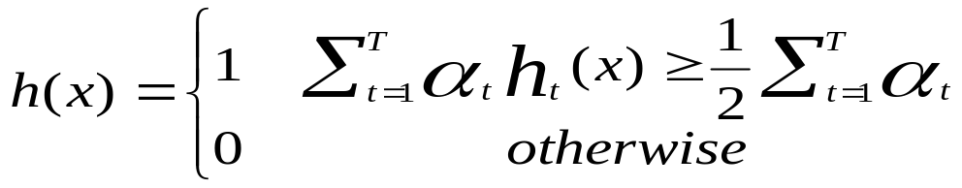
AdaBoost - Getting the idea…
Overview | Integral Image | AdaBoost | Cascade
(pseudo-code at back-up slide #2)
Given: example images labeled +/-
  Initially, all weights set equally
Repeat T times
  Step 1: choose the most efficient weak classifier that will be a component of the final strong classifier (Problem! Remember the huge number of features…)
  Step 2: Update the weights to emphasize the examples which were incorrectly classified
    This makes the next weak classifier to focus on “harder” examples
Final (strong) classifier is a weighted combination of the T “weak” classifiers
  Weighted according to their accuracy
Notes:
מידע נוסף
AdaBoost is adaptive in the sense that subsequent classifiers built are tweaked in favor of those instances misclassified by previous classifiers.

Slide 15
AdaBoost – Feature Selection
Overview | Integral Image | AdaBoost | Cascade
Problem
On each round, large set of possible weak classifiers (each simple classifier consists of a single feature) – Which one to choose?
  choose the most efficient (the one that best separates the examples – the lowest error)
  choice of a classifier corresponds to choice of a feature
At the end, the ‘strong’ classifier consists of T features
Conclusion
AdaBoost searches for a small number of good classifiers – features (feature selection)
adaptively constructs a final strong classifier taking into account the failures of each one of the chosen weak classifiers (weight appliance)
AdaBoost is used to both select a small set of features and train a strong classifier
Notes:
מידע נוסף
AdaBoost is adaptive in the sense that subsequent classifiers built are tweaked in favor of those instances misclassified by previous classifiers.

Slide 16
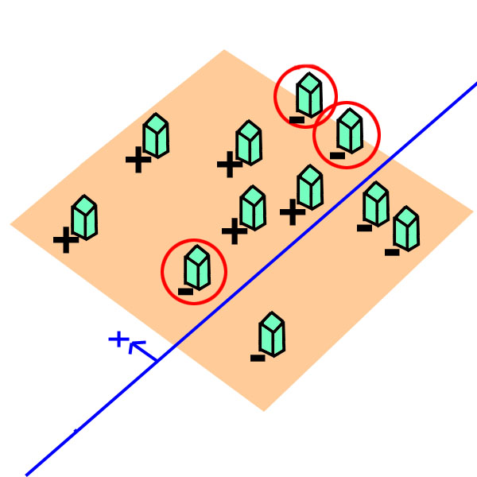
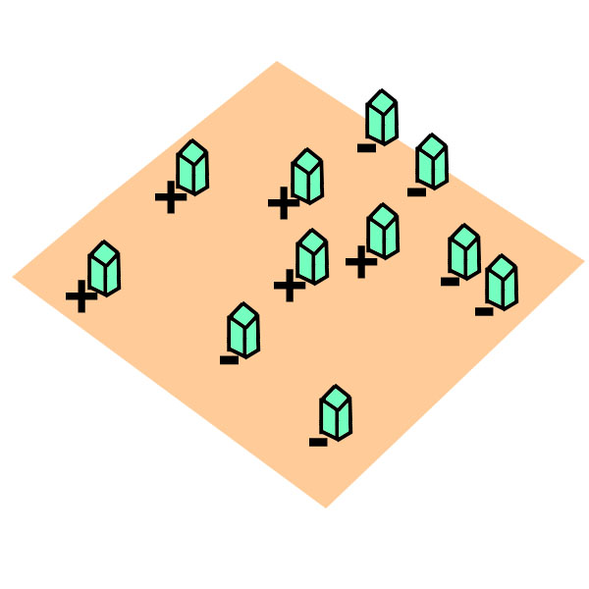
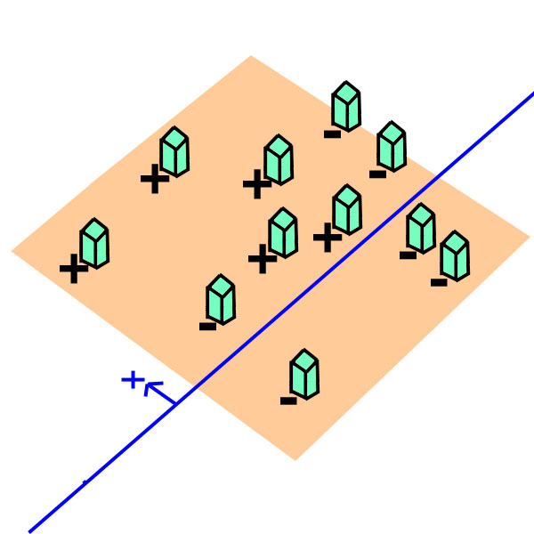
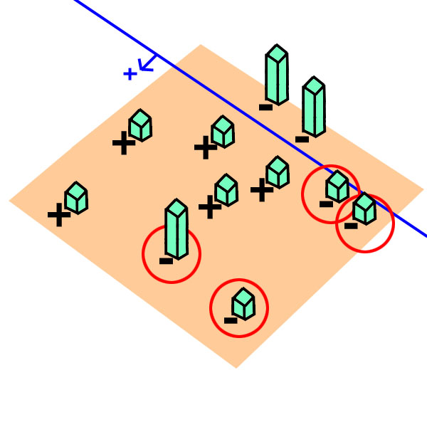
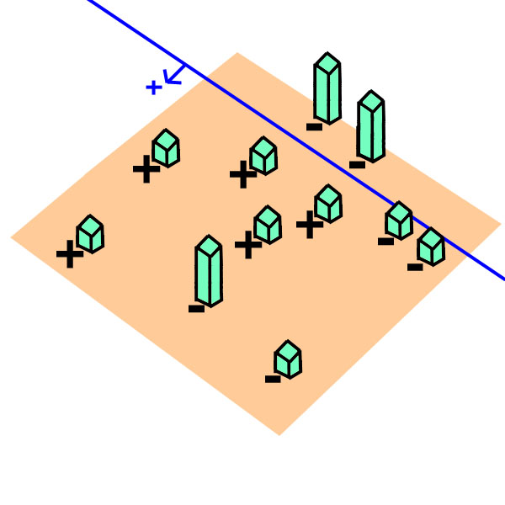
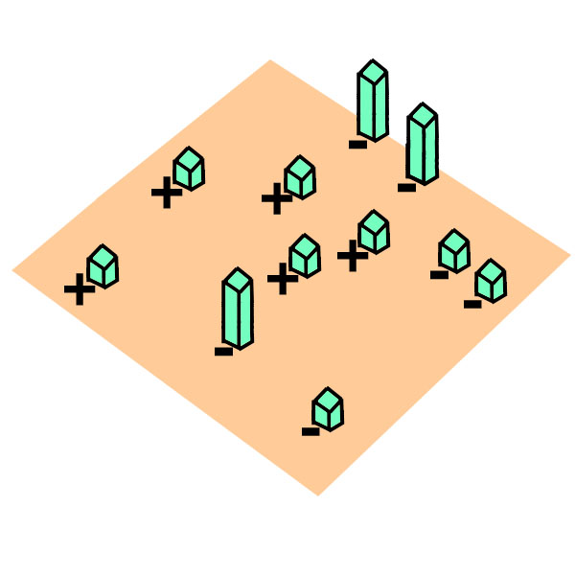
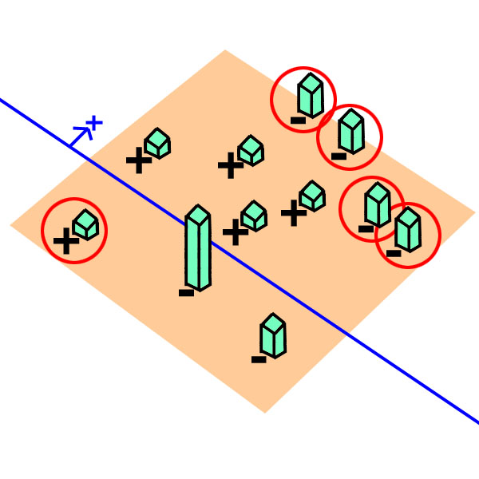
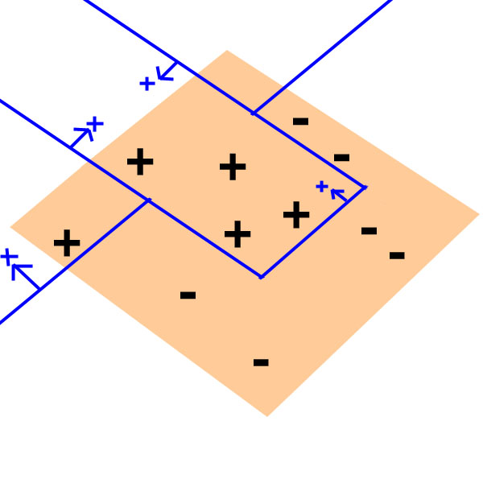
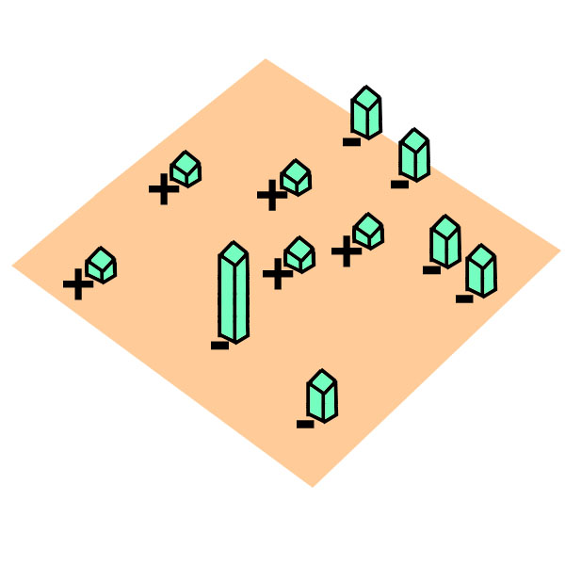
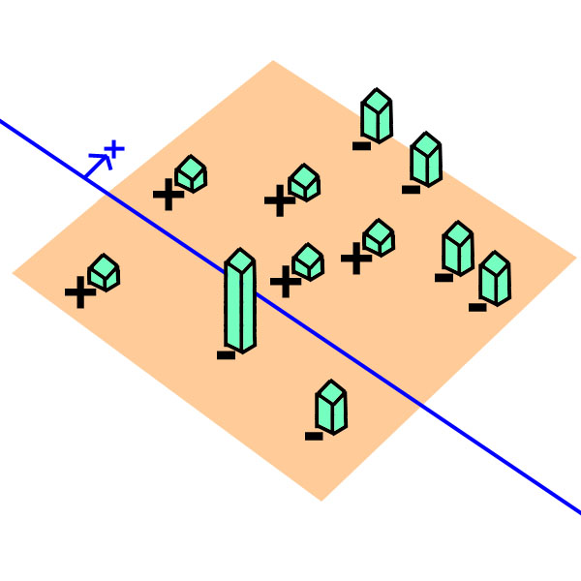
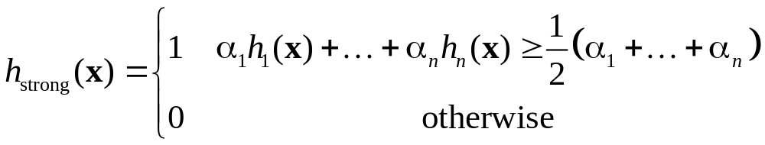
AdaBoost example
Overview | Integral Image | AdaBoost | Cascade
AdaBoost starts with a uniform distribution of “weights” over training examples.
Select the classifier with the lowest weighted error (i.e. a “weak” classifier)
Increase the weights on the training examples that were misclassified.
(Repeat)
At the end, carefully make a linear combination of the weak classifiers obtained at all iterations.
Slide taken from a presentation by Qing Chen, Discover Lab, University of Ottawa
Notes:
לספר לאנשים מה הם רואים
כל Weak classifier ממושקל (a) לפי ההצלחה שלו בפני עצמו.
ה Classifier החזק מנצחי לפי Weighted majority של המשקלים הללו.
מידע נוסף
לצירוף הלינארי בסוף הם קוראים Perceptron.

Slide 17
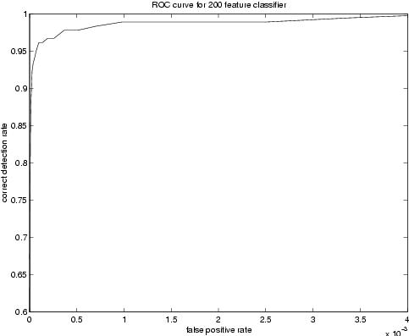
Now we have a good face detector
Overview | Integral Image | AdaBoost | Cascade
We can build a 200-feature classifier!
Experiments showed that a 200-feature classifier achieves:
  95% detection rate
  0.14x10⁻³ FP rate (1 in 14084)
  Scans all sub-windows of a 384x288 pixel image in 0.7 seconds (on Intel PIII 700MHz)
The more the better (?)
  Gain in classifier performance
  Lose in CPU time
Verdict: good & fast, but not enough
  Competitors achieve close to 1 in a 1.000.000 FP rate!
  0.7 sec / frame IS NOT real-time.
Notes:
מידע נוסף
AdaBoost is adaptive in the sense that subsequent classifiers built are tweaked in favor of those instances misclassified by previous classifiers.

Slide 18
Three goals
Overview | Integral Image | AdaBoost | Cascade
Feature Computation: features must be computed as quickly as possible
Feature Selection: select the most discriminating features
Real-timeliness: must focus on potentially positive image areas (that contain faces)
How did Viola & Jones deal with these challenges?
Notes:
בשר המאמר מתחיל בעצם עכשיו – עד עכשיו הדגמה.

Slide 19
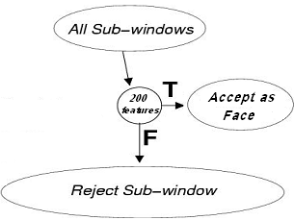
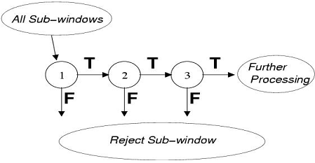
The attentional cascade
Overview | Integral Image | AdaBoost | Cascade
On average only 0.01% of all sub-windows are positive (are faces)
Status Quo: equal computation time is spent on all sub-windows
Must spend most time only on potentially positive sub-windows.
A simple 2-feature classifier can achieve almost 100% detection rate with 50% FP rate.
That classifier can act as a 1st layer of a series to filter out most negative windows
2nd layer with 10 features can tackle “harder” negative-windows which survived the 1st layer, and so on…
A cascade of gradually more complex classifiers achieves even better detection rates.
On average, much fewer features are computed per sub-window (i.e. speed x 10)

Slide 20
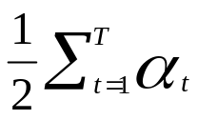
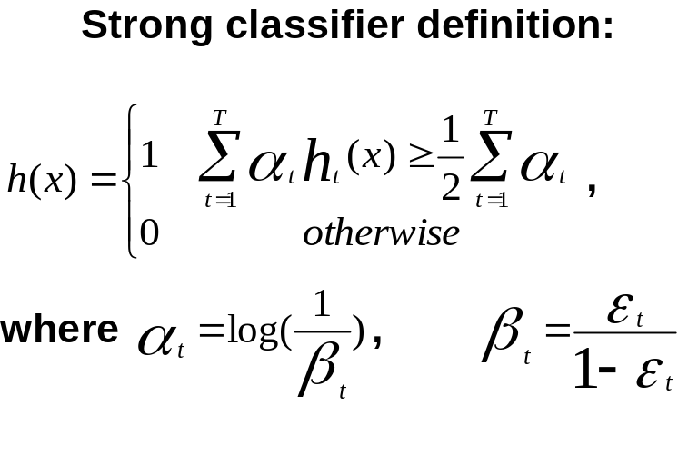
Training a cascade of classifiers
Overview | Integral Image | AdaBoost | Cascade
Keep in mind:
  Competitors achieved 95% TP rate,10⁻⁶ FP rate
  These are the goals. Final cascade must do better!
Given the goals, to design a cascade we must choose:
  Number of layers in cascade (strong classifiers)
  Number of features of each strong classifier (the ‘T’ in definition)
  Threshold of each strong classifier (the in definition)
Optimization problem:
  Can we find optimum combination?
TREMENDOUSLY
DIFFICULT
PROBLEM

Slide 21
A simple framework for cascade training
Overview | Integral Image | AdaBoost | Cascade
Do not despair. Viola & Jones suggested a heuristic algorithm for the cascade training: (pseudo-code at backup slide # 3)
  does not guarantee optimality
  but produces a “effective” cascade that meets previous goals
Manual Tweaking:
  overall training outcome is highly depended on user’s choices
  select f_{i} (Maximum Acceptable False Positive rate / layer)
  select d_{i} (Minimum Acceptable True Positive rate / layer)
  select F_{target} (Target Overall FP rate)
  possible repeat trial & error process for a given training set
Until F_{target} is met:
  Add new layer:
    Until f_{i} , d_{i} rates are met for this layer
      Increase feature number & train new strong classifier with AdaBoost
      Determine rates of layer on validation set

Slide 22
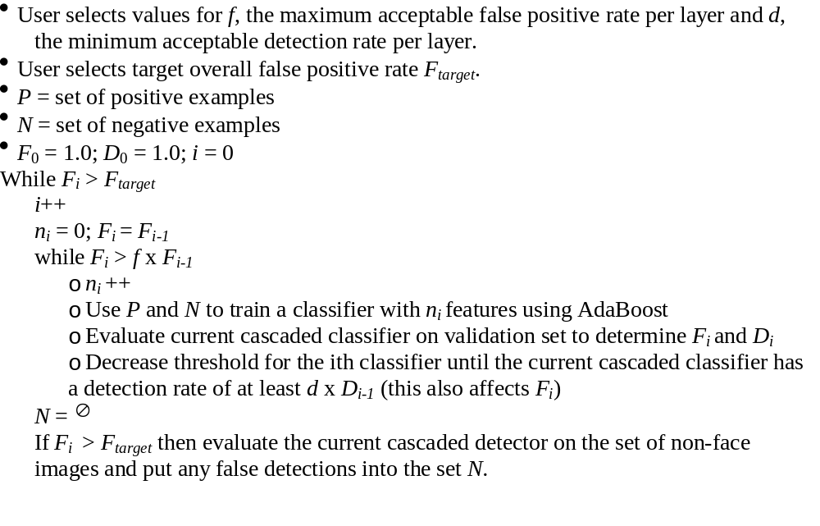
backup slide #3
Overview | Integral Image | AdaBoost | Cascade
Notes:
הגדרה:
בע"פ: היצוג האינטגרלי של תמונה בנקודה X,Y הוא סכום הפיקסלים שמעל ומשמאל לנקודה, כולל.
פרומאלית:
רקורסיבית
חישוב במעבר אחד
סיבוכיות זמן כגודל התמונה

Slide 23
Three goals
Overview | Integral Image | AdaBoost | Cascade
Feature Computation: features must be computed as quickly as possible
Feature Selection: select the most discriminating features
Real-timeliness: must focus on potentially positive image areas (that contain faces)
How did Viola & Jones deal with these challenges?
Notes:
בשר המאמר מתחיל בעצם עכשיו – עד עכשיו הדגמה.

Slide 24



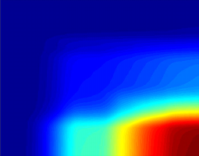





Training phase
Overview | Integral Image | AdaBoost | Cascade
Testing phase
Cascade trainer
Classifier cascade framework
Training
Set
(sub-windows)
Integral
Representation
Strong Classifier 1
(cascade stage 1)
Feature
computation
Strong Classifier 2
(cascade stage 2)
AdaBoost
Feature Selection
Strong Classifier N
(cascade stage N)
FACE IDENTIFIED
Notes:
בשר המאמר מתחיל בעצם עכשיו – עד עכשיו הדגמה.

Slide 25
pros …
Extremely fast feature computation
Efficient feature selection
Scale and location invariant detector
  Instead of scaling the image itself (e.g. pyramid-filters), we scale the features.
Such a generic detection scheme can be trained for detection of other types of objects (e.g. cars, hands)
… and cons
Detector is most effective only on frontal images of faces
  can hardly cope with 45º face rotation
Sensitive to lighting conditions
We might get multiple detections of the same face, due to overlapping sub-windows.

Slide 26
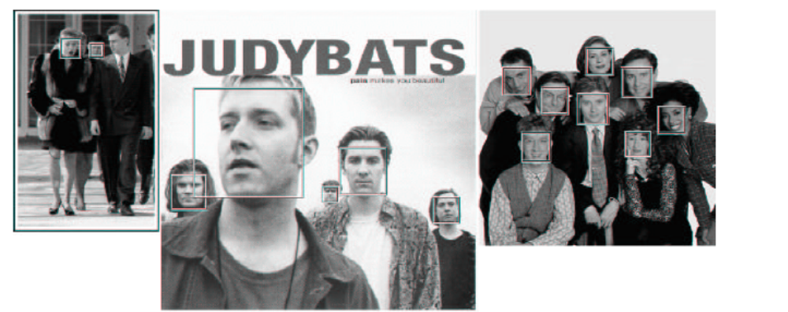
Results
(detailed results at back-up slide #4)
Notes:
תוצאות אמיתיות מהניסוי

Slide 27
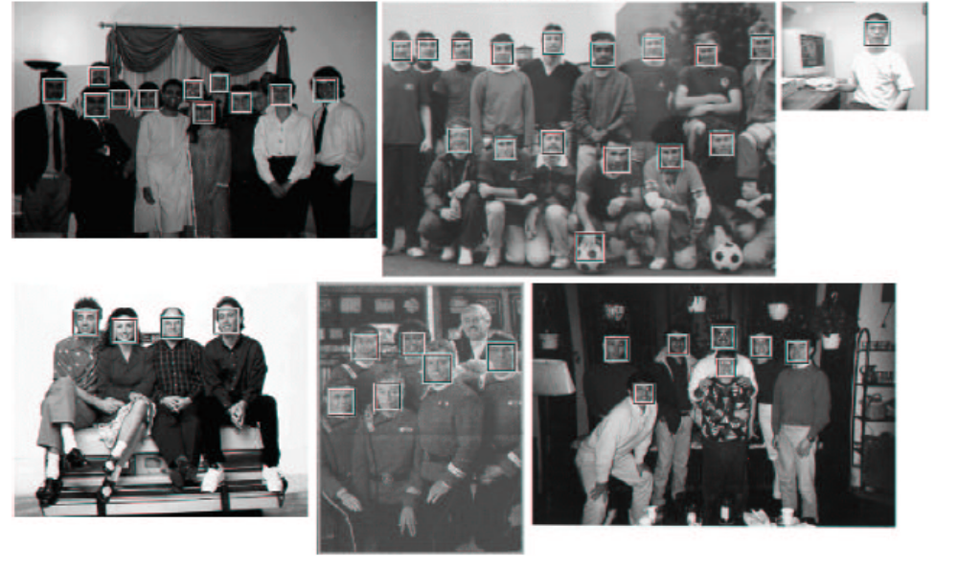
Results (Cont.)

Slide 28
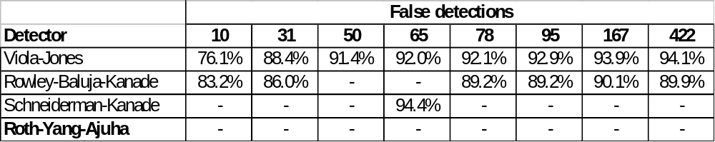
backup slide #4
Viola & Jones prepared their final Detector cascade:
  38 layers, 6060 total features included
  1st classifier- layer, 2-features
    50% FP rate, 99.9% TP rate
  2nd classifier- layer, 10-features
    20% FP rate, 99.9% TP rate
  next 2 layers 25-features each, next 3 layers 50-features each
  and so on…
Tested on the MIT+MCU test set
a 384x288 pixel image on an PC (dated 2001) took about 0.067 seconds
Detection rates for various numbers of false positives on the MIT+MCU test set containing 130 images and 507 faces (Viola & Jones 2002)

Slide 29
Thank you for listening!

